Slide 1


SEPTEMBER 2023
On Beach-houses and Savings
Exploring The Distributional Impacts of Stage 3 Tax Cuts
Sreehari Pulickamadhom Sreedhar

Slide 2
SRC 2023
01
Sam
Stage 3 Tax Cuts
—
Taxable income - $40,000
No savings
From July 2024,​
On Beach-houses and Savings
02
Another Sam
- Increase the floor of the highest tax bracket from $180,001 to $200,001
​
- Remove the bracket between $120,001 and $180,000, previously taxed at 37%
​
- Introduce a new tax bracket between $45,001 and $200,00, to be taxed at 30%
Taxable income - $80,000
Saves $1415
1.77% of income
03
The third Sam
Taxable income - $200,000
Saves $9075
4.54% of income

Slide 3

Data and Methods
Microsimulation
"In the social sciences, a microsimulation model is a computer program that mimics the operation of government programs and demographic processes on individual ("micro") members of a population -people, households, or businesses, for example."
- Urban Institute
2% Sample file (ATO, 2021)
Census of Population and Housing (ABS, 2021)

Slide 4
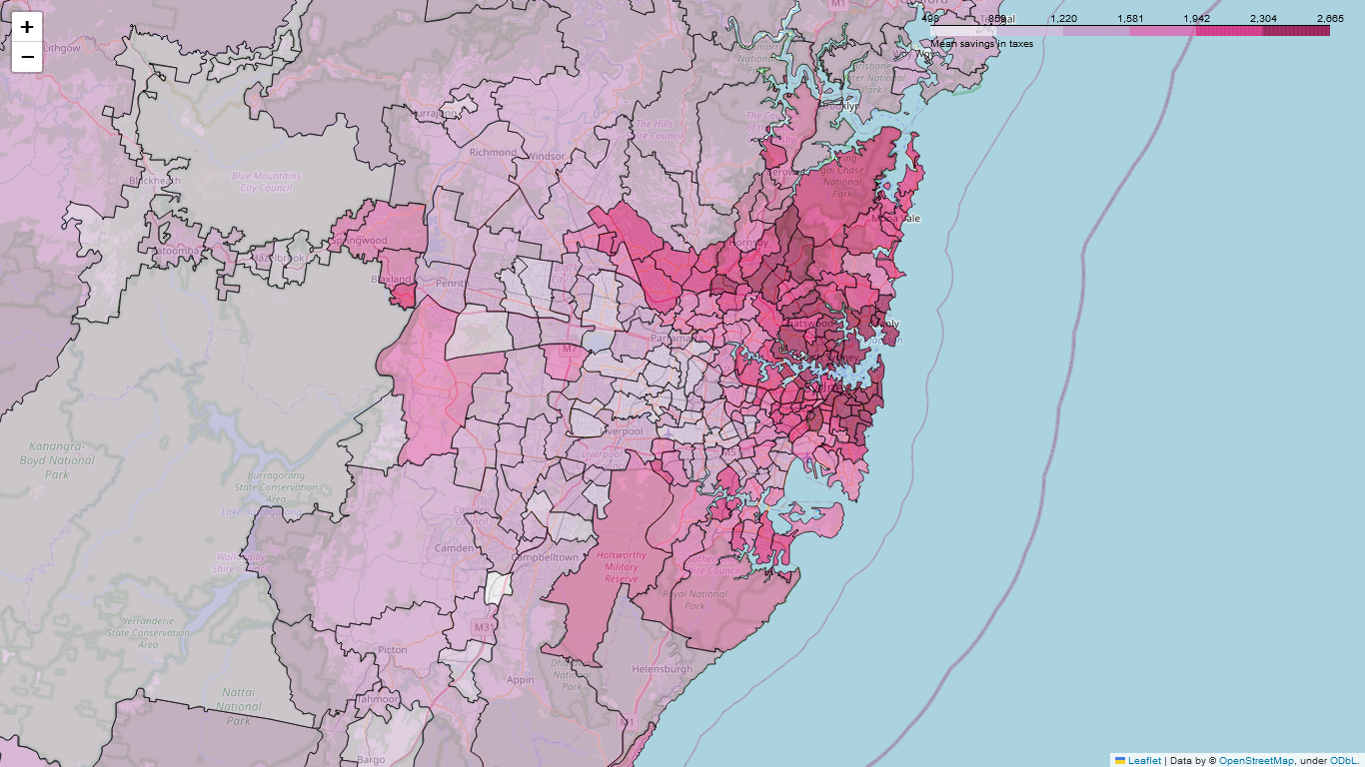

Slide 5
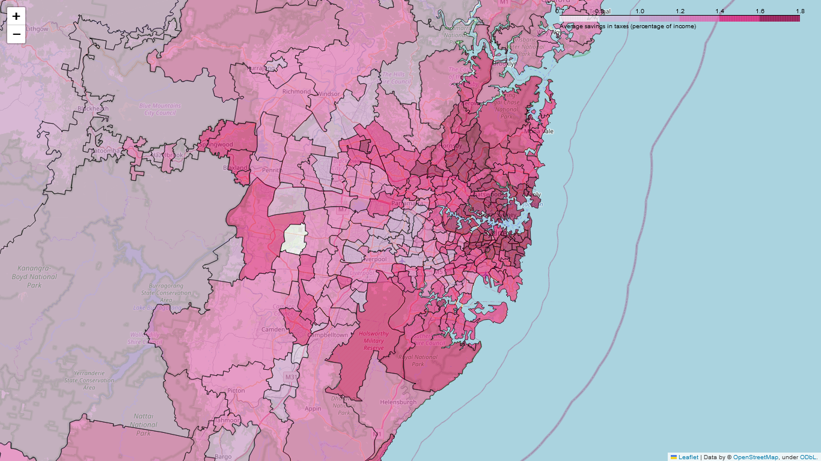

Slide 6
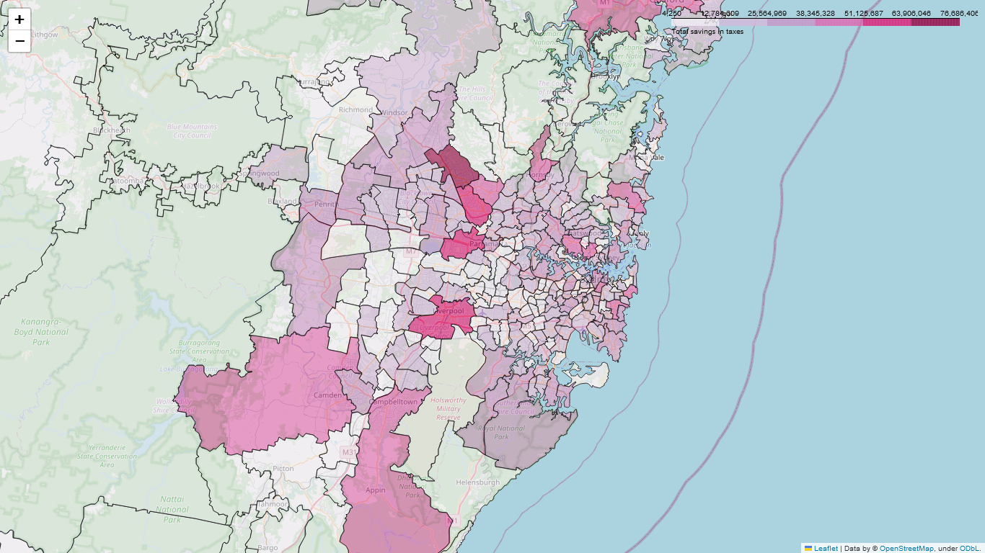

Slide 7
SRC 2023
Where to from here?
On Beach-houses and Savings
Calibrate model further
Modeling behavioral dynamics
Simulate wider range of policies
Try to find better policies

